Slide 1
Data Modeling Concepts Part 1
<Data Model 101 Series>
Anand Kumar
Notes:
Hello friends
I am Maheeja, and today I shall take you through one of the key elements of a data-warehouse, what is called a data model. We have put together few concepts that will explain you all about it. At the end of this session, you would get a fair idea of what data modeling is and a bit on its role in Business processes.
We shall begin our session with an overview of data modeling.
© 2009 Wipro Ltd – Internal & Restricted
‹#›

Slide 2
Data Modeling Overview
A method by which the enterprise business model is defined in terms of data elements and the relationships existing among those data elements.
Provides data view of the business model in a graphical representation of data elements as entity sets and business rules as relationships lines connecting the entity sets.
The data modeling details are covered in three parts,
Part 1 – Introduction to Database System and Context of Data Modeling.
Part 2 & 3 - Data Modeling terms and concepts and Data Modeling in Data Warehouse environment.
Notes:
Data Modeling is a process by which the enterprise business model is defined in terms of data elements and the relationships existing among those data elements.
The enterprise business models are like order processing system, dispatch system, employee management system etc. These are based on the various processes that can exist inside the enterprise. Each process is defined in terms of data elements and the business rules. Data modeling is the logical structuring of these elements and rules.
There are many benefits of Data modeling such as:
-Easy access to information and easy modification of information.
-Less storage space as data redundancy is reduced and so less cost of data maintenance.
-Easy to incorporate new changes and scalable. A business model goes through changes overtime, the data model provides the flexibility to adopt these changes.
These details are covered in three parts. This presentation is part 1 of the series.

Slide 3
Data Modeling Objectives
Upon completion of this module you will be able to:
Understand What is Database Systems
The importance of Data Model
How the Data Model is developed from business model
Notes:
Before we begin with understanding data modeling, it is important to understand what data is, what constitutes a database, what is a business process and more. Because these form the various inputs to create a data model.
Upon completion of this module you will be able to,
-Understand What is Database Systems,
-The importance of Data Model,
-And How the Data Model is developed from the business model.

Slide 4
Data Modeling Outline
Lesson 1 Introduction to Database Systems
Lesson 2 Context for Modeling
Notes:
This module has 2 Lessons.
The first one is Introduction to Database Systems.
The second one is Context For Modeling.
© 2009 Wipro Ltd – Internal & Restricted
‹#›

Slide 5
Introduction to Database Systems
Notes:
Let us start with the Introduction to Database Systems.
In simple terms, a database system provides space for data storage and provide ways or methods to use the stored data. The data could be business process data which is stored in a particular logically related way, so that it can provide meaning to the user.
Here you will be explained the definitions of Database System, Database Management System, RDBMS and Data Model.

Slide 6
Introduction to Database Systems
Data
A known fact that can be recorded and that have implicit meaning
Database
A collection of related data with the following implicit properties
A database is a logically coherent collection of data with some inherent meaning
A Database is designed, built, and populated with data for a specific purpose
Notes:
The database system primarily deals with data.
Let us understand what is data.
Data is a known fact that can be recorded and that has implicit meaning.
for e.g. an employee data would be:
Name: Ram,
Location: Delhi,
Date of Joining: 01/01/2001
Skills: Oracle, Java
Current project: Order management system
This is raw data and it contains lots of information of an employee. If the complete information about each employee is stored in such form, then it is difficult to present and maintain. By ‘maintaining’ we mean the application of select, insert, update and delete operations. This might also lead to huge data redundancy.
What is the solution of this problem? Database.
To overcome the difficulty of data maintenance, the data is logically arranged in different entities (tables) which are related to each other with some business rules. This facility is provided by database.
Hence we can define a database as a logically coherent collection of data, with some inherent meaning, which is designed, built, and populated with data for a specific purpose.
© 2009 Wipro Ltd – Internal & Restricted
‹#›

Slide 7
Introduction to Database Systems
Database Management System (DBMS)
A collection of programs that enables users to create and maintain a database
A general purpose software system that facilitates the process of defining, constructing and manipulating database for various applications
Database System
A collection of programs that enables users to create and maintain a database
data stored as database
Notes:
Let us proceed to Database Management System and Data base systems.
The Database management System :
It is general purpose software system that facilitates the process of defining, constructing and manipulating database for various applications.
This is managed by different tools, programs or processes that run inside the software. Few of them are data storing (tables, indexes), applying data integrity rules like primary key, foreign key etc. and managing data access and data manipulation like select, update etc.
Database System
Database and Database Management System software together form a database system.
Oracle, Sybase, DB2 are few examples of database system

Slide 8
Introduction to Database Systems
Users / Programmers
Database System
Application Programs / Queries
DBMS Software
Software to Process Queries / Programs
Software to Access Stored Data
Stored Database Definition (Metadata)
Stored Database
Notes:
What you see here is a typical architecture of a database system.
The various layers of the system are:
The top layer: Here is the Database management system Software which provides SQL (Structured Query Language) to end users to query the database. When a single user or multiple users interact with database to use the data, the user instructions are passed to internal programs.
The middle layer : In this layer, are the internal programs that manage data concurrency, data storing and retrieval, user access control, database backup, restore etc.
The bottom layer : This layer has metadata and stored data.
“Metadata is information of stored data and is kept in tables and views.
“The stored data has two parts: logical structure and physical structure. The logical structure includes tables and physical structure includes data files.
The application developed say in Java or C or any other language or tool talk to database system via drivers. These drivers are JDBC driver, ODBC driver etc.

Slide 9
Introduction to Database Systems
Model
Representation of a set of business requirements in a standard structured framework understood by the users
Data Model
A collection of concepts that can be used to describe the structure of a database
Most data models include a set of basic operations for query and updates on the database
Notes:
The Database Systems needs a model on which the data structure is defined and data is stored.
The model is termed as : Representation of a set of business requirements in a standard structured framework understood by the users.
A model provides a typical way to define the business rules. With its own standard framework.
For e.g. object model of data representation is different than the hierarchal model representation.
In object model the data is organized as data structure and a set of methods to use that data. This model is frequently used in programming language like Java and C++.
In hierarchal model the data is organized in tree like structure and data is repeated in parent child information.
Data Model: is defined as a collection of concepts that can be used to describe the structure of a database.
The various data models are hierarchal model, relational model, network model and object model.
According to the need of various organizations and applications the various models are used.

Slide 10
Introduction to Database Systems
RDBMS
It is a system in which, at a minimum :
The data is perceived by the user as tables (and nothing but tables )
The operators at the user’s disposal - e.g., for data retrieval - are operators that generate new tables from old, and those include at least SELECT, PROJECT, and JOIN
Features of an RDBMS
The ability to create multiple relations (tables) and enter data into them
An interactive query language
Retrieval of information stored in more than one table
Provides a Catalog or Dictionary, which itself consists of tables (called system tables)
Notes:
The RDBMS is Relational Database Management System. It stores data in tables and provides relationships among the data.
The data here is perceived by the user as tables only. This is based upon the principles of E. F. CODD.
The data is defined as a set of relations and SELECT, PROJECT, INTERSECT, JOIN like relational operations are provided.
These are same as set operations.
As we have seen, raw data (for e.g. the complete employee data) contains various information. It has employee personal details, location details, skill details and project details.
If all the information is stored in one big record it will be difficult to manage it. So it is divided into various entity sets such as employee table, employee skill table, employee location table etc and are related among themselves with business rules.
-The employee table will have Employee id, Name , Date of joining.
-The Employee Skill table will have employee id and skill.
-The employee location table will have Employee id and location id, location start date and location end date.
-The relation between Employee and Employee Skill tables is ‘Employee has skills’
-The relation between Employee and Location is ‘Employee works for locations.’
The Features of an RDBMS are:
The ability to create multiple relations (tables) and enter data into them
An interactive query language
Retrieval of information stored in more than one table
Catalog or Dictionary, which itself consists of tables (called system tables). This dictionary is an important part of the RDBMS.
Views – These display metadata about tables, for e.g. Who owns the tables, what is the primary key on the table, what are the foreign keys etc. One can just query these views and know the details. To optimize the query it also stores the data statistics, which is used with cost based query optimizer to improve the performance.

Slide 11
Context For Data Modeling
Business Enterprise, Overview
Notes:
Now we come to the second part of the module - Context For Data Modeling
Data Modeling integrates the data and the process of an enterprise. A Data model is developed in the context of business processes of an enterprise.
It has to represent the business process in terms of data structures and business rules.
In this part of the module, we shall cover :
-Process View of a business process,
-Data View of the business process,
-Data Model Roles and Characteristics.
© 2009 Wipro Ltd – Internal & Restricted
‹#›

Slide 12
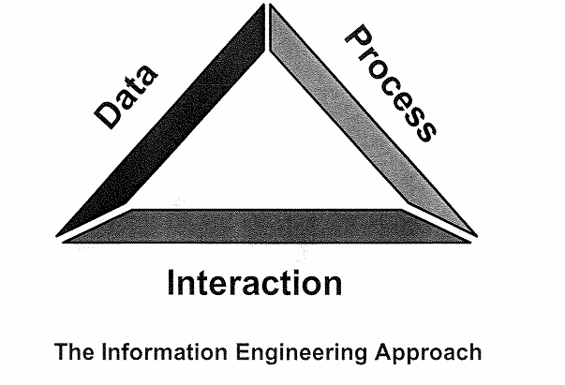
Context for Data Modeling
A model-based approach to business rule definition and systems development considers data and processes requirements and how those requirements interact with one another.
This is an information Engineering (IE) based approach.
Notes:
Data Modeling provides a way to integrate data and business process.
The Information Engineering Approach suggests that there should be a model and the model should consider the interaction of data and process.
Before the model is developed, the business process view has to be present. The data model is developed from the business process view.
This is explained in next few slides.
© 2009 Wipro Ltd – Internal & Restricted
‹#›

Slide 13
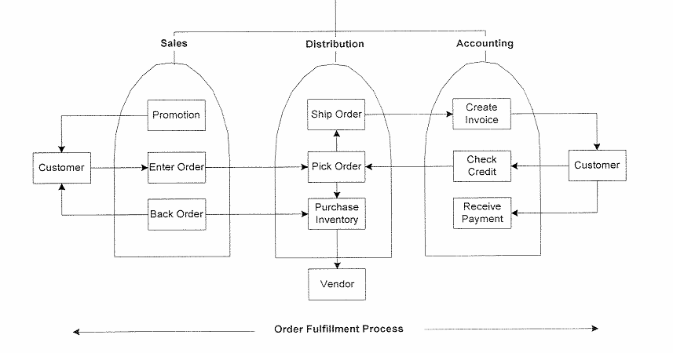
Business Enterprise - Process View
The focus of the process view is to define how the business operates, and it includes activities and dependencies that comprise process-oriented business rules.
It crosses organizational boundaries and includes external entities to depict how an organization conducts business.
Notes:
The focus of the process view is to define how the business operates, what are the business activities and how the data flow happens in various activities.
The process seen here is for Order fulfillment and it shows the data flow from one point to other point.
The customer places an order. It goes to sales department. The department considers order detail. It also looks into whether it is a fresh order or a backdated order or if the order is placed because of some promotion.
The sales department passes the order details for distribution and shipment to distribution department. The Distribution department considers the shipping details such as - where to the ordered item are to be shipped. It also interacts with Inventory to check if the ordered item is present or needs to be procured.
From distribution department, the order detail now is sent to accounting team. Here the invoice is generated. Customer credit is checked and accordingly invoice is sent to customer. The customer pays the bill.
Now all these activities are governed by rules.
A customer places and order to only sales department, and not to the Accounting or distribution department.
A customer may or may not utilize the promotion given by company.
The date of the order received has to be verified.
The accounting department can not prepare invoice unless order is delivered by distribution department.
All these rules get incorporated in data model.

Slide 14
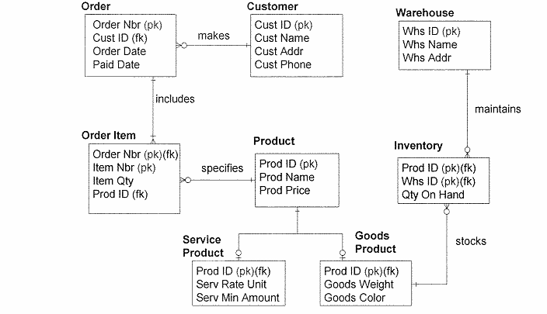
Business Enterprise – Data View
The focus of the data view is to define what information the business needs to support itself.
This includes category and detailed information that comprise data-oriented business rules.
Notes:
From the process view of previous slide the various data elements (entities) are picked up and there relations are defined in the data view.
Data related to particular business process are picked up and not the whole activity of the enterprise.
From previous example following data elements are considered.
Customer, Order, Ordered item, Product, Service Product, Goods Product, Inventory and Warehouse.
The relationship developed among these data elements ( or entity types) are:
-Customer places an order,
-The order has ordered items,
-The items has product details,
-The product can be a service product or a goods product,
-The goods product has inventory,
-The inventory is maintained in warehouse.
The lines between boxes (data elements) are relationships ( or business rules) – these have different meaning based upon the symbols used on the line. This will be explained in part 3 of this series.

Slide 15
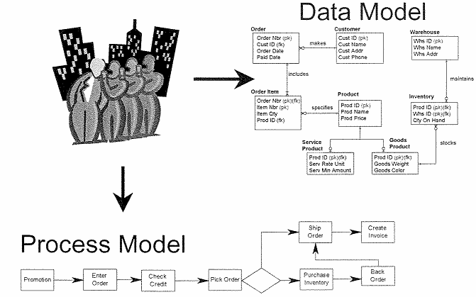
Business Enterprise Overview
Process modeling and data modeling each view the same business reality from different perspective. Separately each has values and omissions.
Together they form a clear picture of an enterprise or system.
Notes:
Process modeling and data modeling each view the same business reality from different perspective. Separately each has values and omissions.
The business people are more at ease with process model, they understand it better, it is more about the flow of data.
The technical people (software/hardware developers, designers) understand data model more clearly. Technical people have to dive into the business process model and derive a robust data model for the business.
The data model shows the various types of data like customer data, order data etc and how these are related to each other through business rules.
Together the process model and data model form a clear picture of an enterprise or system.
The diagram here shows the process model and corresponding data model separately.
The process view has process flow diagram comprising of process, decision boxes etc.
The data model diagram has entity types and relationships details.

Slide 16
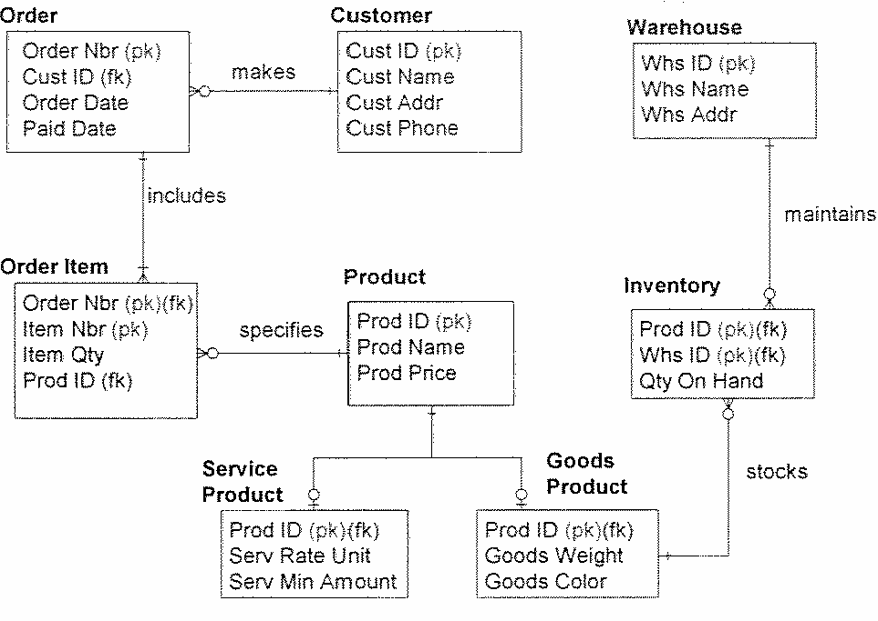
Data Model Overview – Role in Business
The What not How of business
Strategic, Tactical or Operational View
Responsive to Change
Notes:
The data model from a business prospective defines the data elements and interactions among the data elements.
It should be scalable and flexible to incorporate the changes in business model.
Data model plays following roles:
The WHAT and HOW of business: This means, it should show what the data elements and the business rules involved are. The how of business is more clearly depicted with process model.
It should show the business related strategic or tactical or operational view. Each business enterprise has its own way to conduct the business, so its strategy, tactics and operations may differ. The data model has to include this detail. For example some organizations accept orders from customers locally and process it locally. Other have a centralized process dept and all the orders goes through the centralized dept.
It should be responsive to change. The business process keeps changing over the time and so the data model has to be flexible to incorporate those changes. For example the company can put some of its sales items on promotion for some time to boost the sales, and later on revoke this offer. The data model should accommodate these changes.

Slide 17
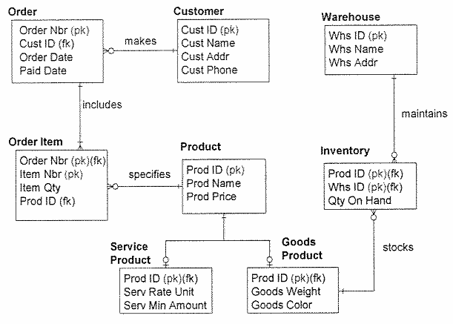
Data Model Overview - Characteristics
Graphical picture of:
The things a business cares about
How they relate to each other
Notes:
The Characteristics of data model are:
It is a graphical representation of business data elements and the relationships amongst them.
Let us understand the diagram given here.
The example here shows a representation of order processing system. It has Customer, Order, Order Item, Product, Inventory, Service Product, Goods Product, Warehouse as data elements or entity types. The line connecting the data elements are relations between entities, which shows how these elements are related to each other.
The Information Engineering notation is used here to show different types of relationships. More details on Information Engineering notation has been covered in part 3 of this series.
Now let us see how the customer and order blocks are related and what business rule it represents.
The business rules would be:
A company has multiple customers.
In a given day the customer can place zero, one or multiple orders with the company.
To represent this in data model, the line connecting from customer to order has a zero symbol and the line is split into three lines before order box.

Slide 18
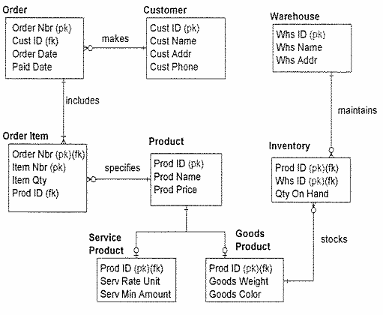
Data Model Overview – Characteristics Contd..
A “model” that is:
A single representation of the information required by all user-views of the enterprise.
Built and rebuilt until it represents real-life data structures
Notes:
Further characteristics of data model are:
The data model is a single representation of the information required by all user-views of the enterprise.
It is built and rebuilt further until it represents real-life data structures
The representation of data model is not changed for business and technical people of the enterprise. Both the parties get the same view, while the business view or the process view can be viewed in multiple ways by business people and technical people. It essentially captures the business rules. If these business rules are not defined correctly at this stage, in later stages, when the interfaces are designed for user interaction with the data model, more changes would have to be carried out. A good data model in online transaction processing system reduces data redundancy.
The data model goes through the process changes to finally come to a shape to represent the real-like data structures.
The relations, attributes, entity types are built and worked on till they become more coherent with the business process. Typically the data model is finalized in high level design phase.
Multiple discussions are carried out with business people to understand the requirement and then the data model is presented to get their approval.
It is also possible that business rules are redefined or fine tuned in a later phase. The project need to accommodate the changes accordingly.

Slide 19
Module Summary
Congratulations! You have now completed the 1st Part of the module Data Modeling Concepts.
You should now be able
What is Data
What is Data Model
What is Database Management System
The characteristics of Data Model
Notes:
This course would have helped you understand Data, Data Model, Database management system and the characteristics of data model, primarily the single graphical representation of business process. How a process is understood in terms of business-process model and data model. And The important role that data model plays in industry.
This completes my presentation on Data Modeling Concepts.
It is now time for a small quiz to test your understanding.
GOOD LUCK and THANK YOU.

Slide 20
Quiz
Notes:
© 2009 Wipro Ltd – Internal & Restricted
‹#›

Slide 21
Question 1
Which of the following form the clear picture of the Enterprise business?
Data view only
Process View only
Data View and Process view together
None of these
Notes:
© 2009 Wipro Ltd – Internal & Restricted
‹#›

Slide 22
Question 1
Which of the following form the clear picture of the Enterprise business?
Data view only
Process View only
Data View and Process view together
None of these
Answer: C
Notes:
© 2009 Wipro Ltd – Internal & Restricted
‹#›

Slide 23
Question 2
Which is not the Feature of RDBMS:
The ability to create tables
Provide a Query language
Provide a catalogue or Dictionary
Data Profiling capability
Notes:
© 2009 Wipro Ltd – Internal & Restricted
‹#›

Slide 24
Question 2
Which is not the Feature of RDBMS:
The ability to create tables
Provide a Query language
Provide a catalogue or Dictionary
Data Profiling capability
Answer: D
Notes:
© 2009 Wipro Ltd – Internal & Restricted
‹#›

Slide 25
Question 3
Which one is correct
The data model provides a relation between data and processes of a business
The data model provides a relation between data and department of a business
The data model provides a relation between department and department of a business
The data model provides a relation between process and department of a business
Notes:
© 2009 Wipro Ltd – Internal & Restricted
‹#›

Slide 26
Question 3
Which one is correct
The data model provides a relation between data and processes of a business
The data model provides a relation between data and department of a business
The data model provides a relation between department and department of a business
The data model provides a relation between process and department of a business
Answer: A
Notes:
© 2009 Wipro Ltd – Internal & Restricted
‹#›

Slide 27
Question 4
Which one is correct
The data model converts business process into data model
The data model converts business rule into data model
The data model converts business data into data model
The data model converts business location into data model
Notes:
© 2009 Wipro Ltd – Internal & Restricted
‹#›

Slide 28
Question 4
Which one is correct
The data model converts business process into data model
The data model converts business rule into data model
The data model converts business data into data model
The data model converts business location into data model
Answer: A
Notes:
© 2009 Wipro Ltd – Internal & Restricted
‹#›

Slide 29
Question 5
Which is not a characteristic of data model
It provides a user view of business model
It provides a graphical view of business model
It is built and rebuilt until it represents a real life data structure
It provides a textual view of business model
Notes:
© 2009 Wipro Ltd – Internal & Restricted
‹#›

Slide 30
Question 5
Which is not a characteristic of data model
It provides a user view of business model
It provides a graphical view of business model
It is built and rebuilt until it represents a real life data structure
It provides a textual view of business model
Answer: D
Notes:
© 2009 Wipro Ltd – Internal & Restricted
‹#›

Slide 31
References

Slide 32
References
Publications
Courses
Course structure was conceptualized from Business Data Modeling training course offered by Inteq Group
Fundamentals of Database Systems by R Elmasri, S Navathe, Publisher - Addison Wesley
DWH Concepts
URL’s
Training Programs
www.learndatamodeling.com
www.agiledata.org
Wipro Data warehousing Training Material

Slide 33
Thank You
Anand Kumar
Project Lead
Anand.akumar@wipro.com

